Slide 1
Daryl Morey Group
Andrew Cannon, Bradley Brown, Chris Harden, Felicia Seng, Isaac Corcoran, Jordan Khamvongsouk

Slide 2
Agenda
Project Overview
Overview of Project and data sources
Modeling and Variable Selection
Models Used to Predict NBA Team Success
Conclusion
Findings From Analysis and Model
Website Walkthrough
Data deep-dive
Further Exploration
Potential improvements and other areas of investigation

Slide 3
Agenda
Project Overview
Overview of Project and data sources
Modeling and Variable Selection
Models Used to Predict NBA Team Success
Conclusion
Findings From Analysis and Model
Website Walkthrough
Data deep-dive
Further Exploration
Potential improvements and other areas of investigation

Slide 4
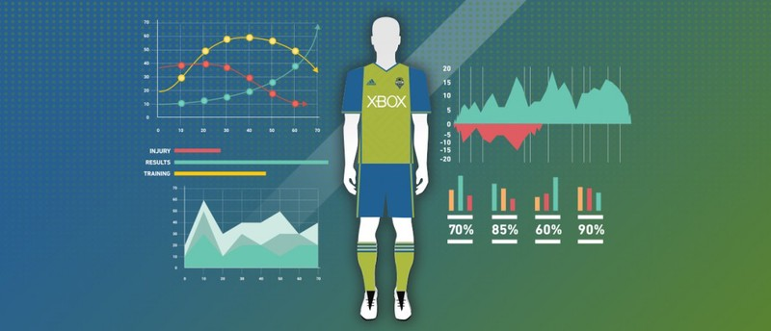

Slide 5
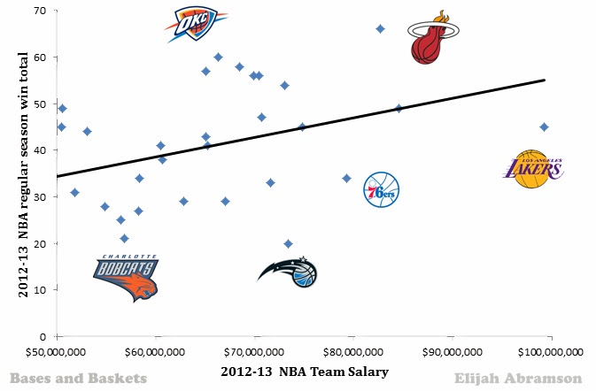

Slide 6



HTML
Notes:
Most or our data came from web scraping - We ran into some issues regarding completeness, and consistency. It was important to us to make sure that we had enough data to have a solid amount to train and test our model with.

Slide 7
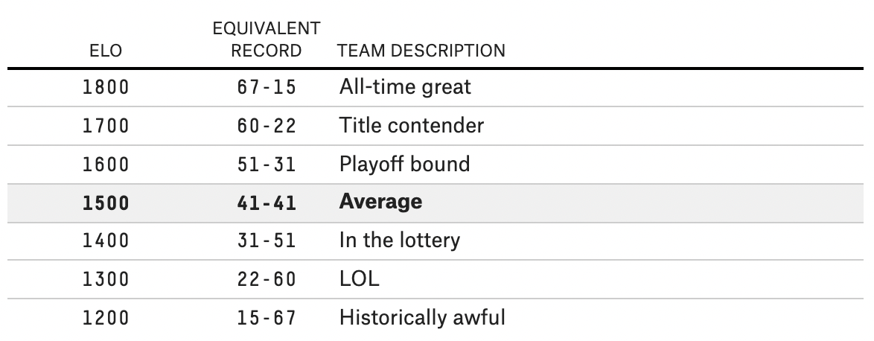
Notes:
KOBE!

Slide 8
Agenda
Project Overview
Overview of Project and data sources
Modeling and Variable Selection
Models Used to Predict NBA Team Success
Conclusion
Findings From Analysis and Model
Website Walkthrough
Data deep-dive
Further Exploration
Potential improvements and other areas of investigation

Slide 9
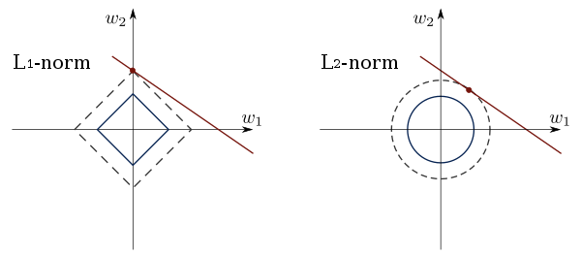
Variable Selection
Lasso
Ridge Regression
Elastic NET

Slide 10
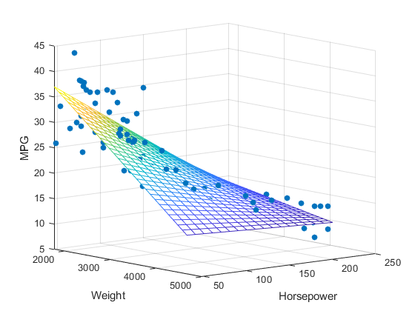
Linear Model
Benefits:
Works with almost any kind of data
Very informative and interpretable models
Downsides:
Many assumptions have to met

Slide 11
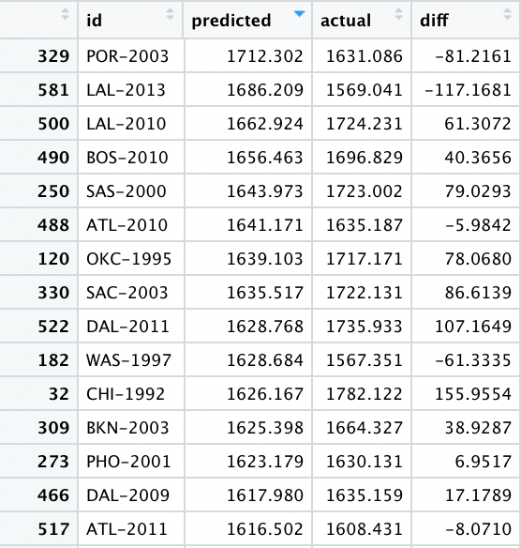
Results
Predictions for max Elo were within a reasonable range (+/- 75) of the actual max Elo for a team 73.44% of the time
The most egregious prediction was the 2010 New York Knicks, when the model was off by 259 points. Predicted: 1215 (Historically Awful), Actual: 1474 (Average Team)
The most accurate prediction was the 1995 Denver Nuggets, where the model predicted 1596.4 and the actual was 1597.4.
The model considered the following variables to be significant, listed by order of significance:
tot_spVORP
tot_spWS
min_spPTS
std_sal
tot_sal
min_spPER

Slide 12
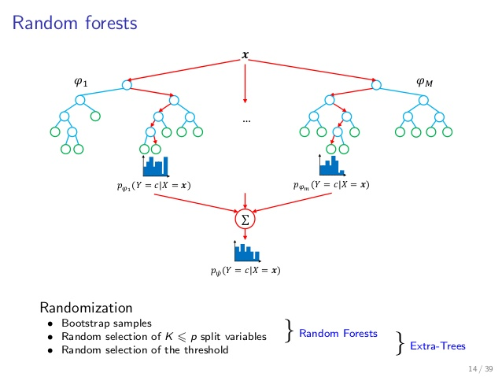
Benefits:
Reduces overfitting
Improves accuracy
Normalized data is not necessary
Downsides:
Less interpretability
Harder to establish variable importance

Slide 13
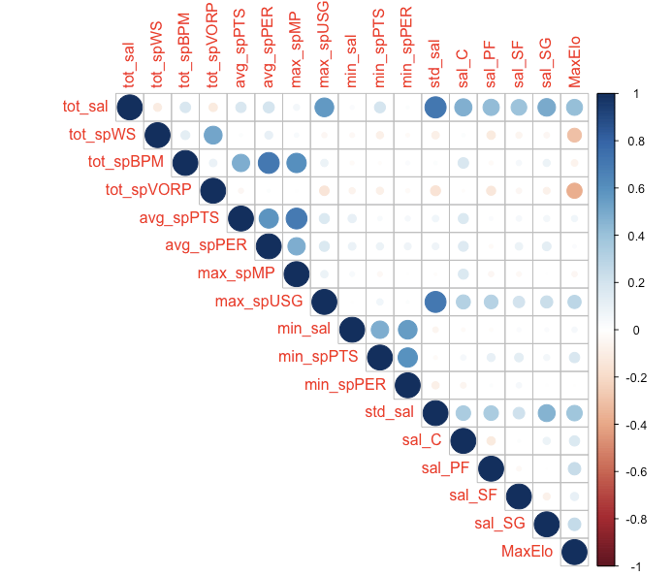
Random Forest Model Variables

Slide 14
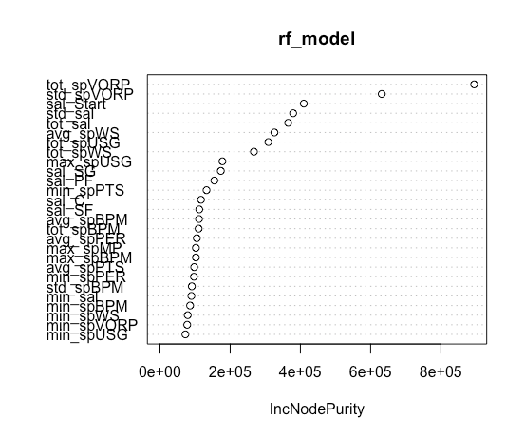
Random Forest Model Variables

Slide 15
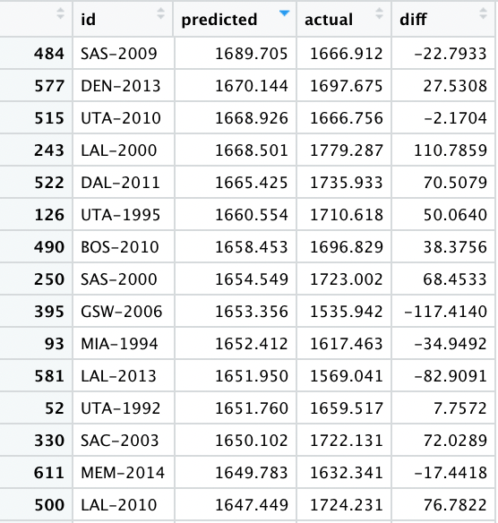
Results
Predictions for max Elo were within a reasonable range (+/- 75) of the actual max Elo for a team 85.94% of the time
The most egregious prediction was the 2004 San Antonio Spurs, when the model was off by 213 points. Predicted: 1551 (Playoff Bound), Actual: 1764 (Title Contender)
The most accurate prediction was the 2008 Golden State Warriors, where the model predicted 1623.14 and the actual was 1623.10.
The model considered the following variables to be most important, listed in order:
tot_spVORP
std_spVORP
sal_Start
std_sal
tot_sal
avg_spWS

Slide 16
Agenda
Project Overview
Overview of Project and data sources
Modeling and Variable Selection
Models Used to Predict NBA Team Success
Conclusion
Findings From Analysis and Model
Website Walkthrough
Data deep-dive
Further Exploration
Potential improvements and other areas of investigation

Slide 17
Conclusions
Our model is quite good at accurately predicting the category a team will fall into (Lottery Bound, Average Team, Playoff Bound, Title Contender, etc.)
As a team spends less of its salary cap for player production, especially measured by VORP, they tend to perform better during the season, specifically having a higher maximum ELO rating.
Paying for superstars (having large contracts) correlates with having a higher max ELO, especially if you’re able to pay less for other players too, creating a higher standard deviation. Of course, just paying a lot for a player doesn’t guarantee success.

Slide 18
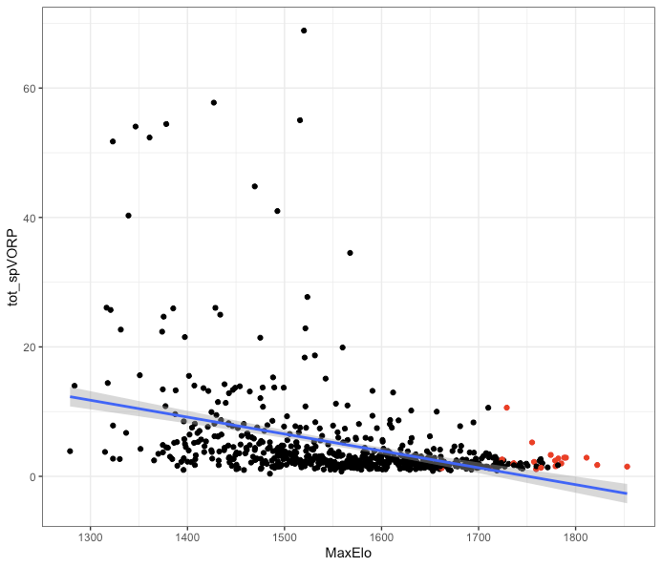
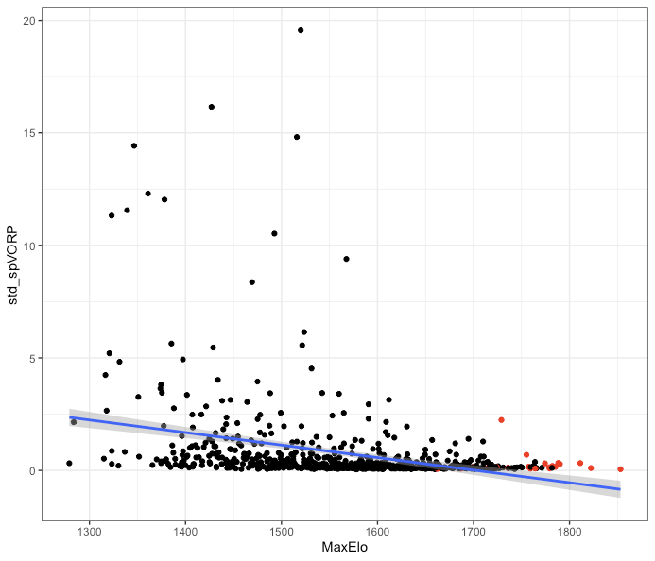
VORP vs Max Elo

Slide 19
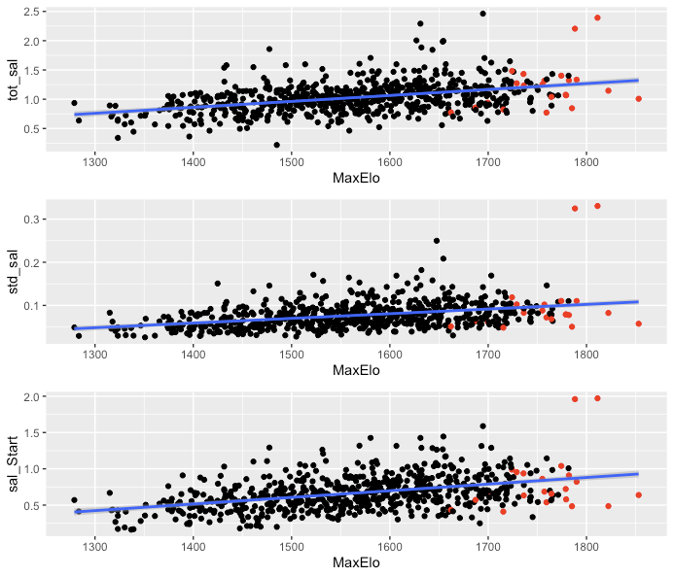
Pure Salary vs
Max Elo

Slide 20
Agenda
Project Overview
Overview of Project and data sources
Modeling and Variable Selection
Models Used to Predict NBA Team Success
Conclusion
Findings From Analysis and Model
Website Walkthrough
Data deep-dive
Further Exploration
Potential improvements and other areas of investigation

Slide 21


Slide 22
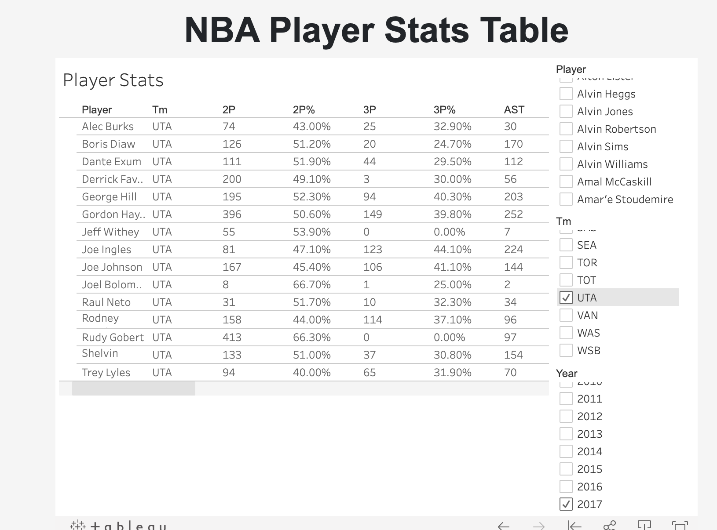

Slide 23
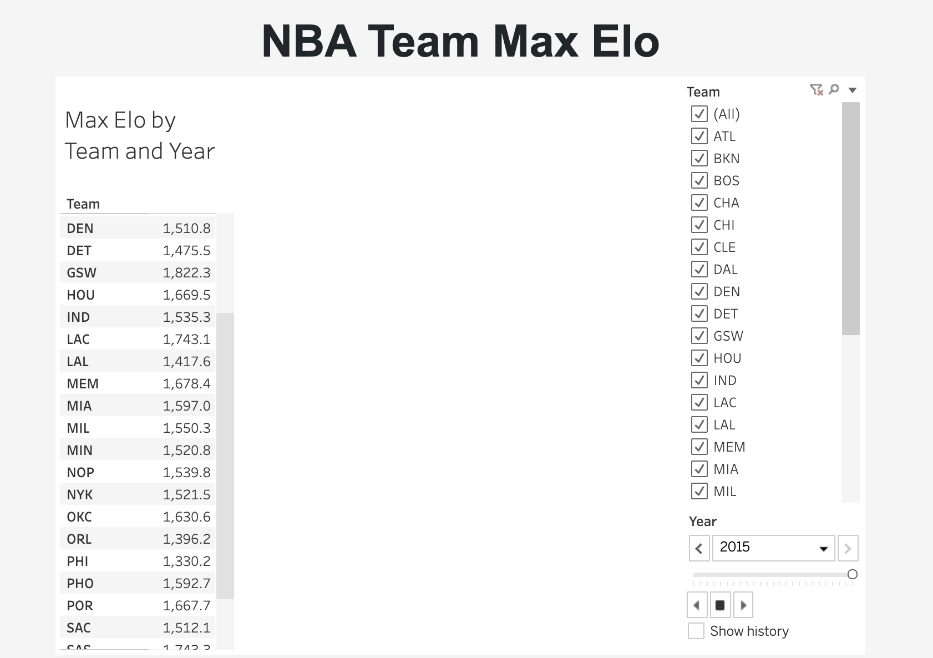

Slide 24
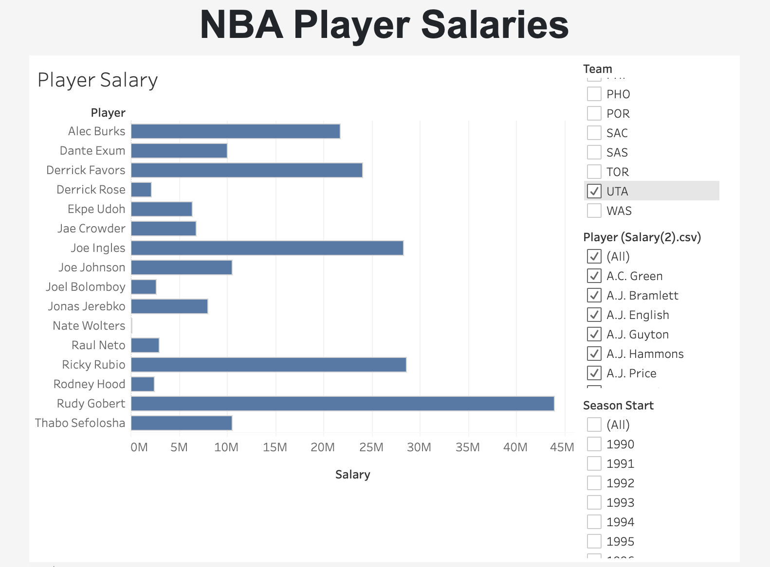

Slide 25
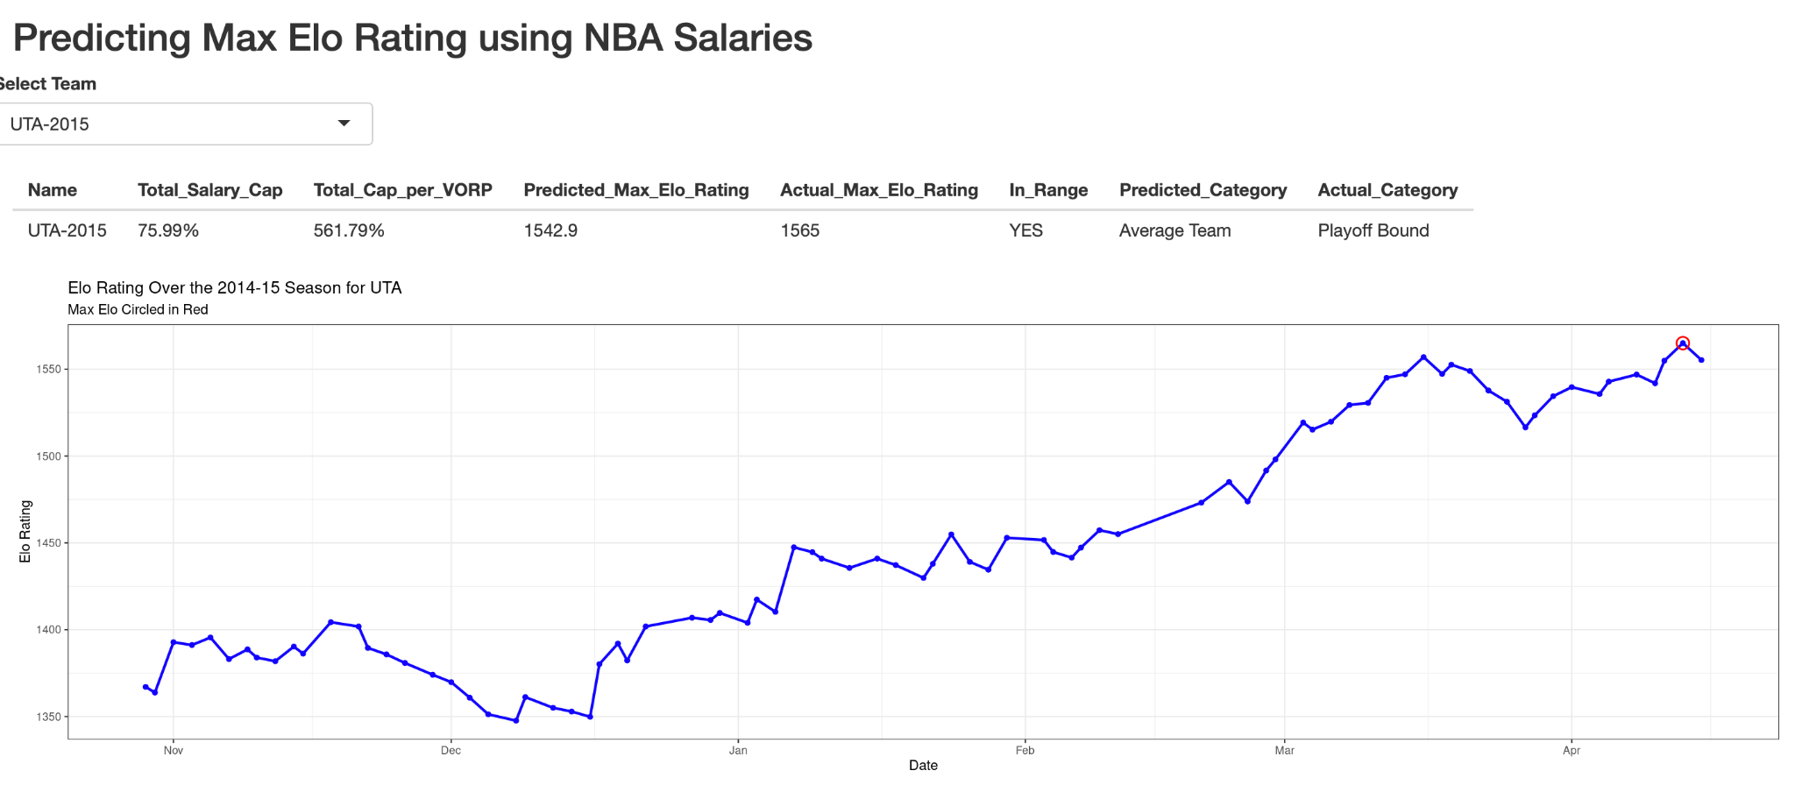
Notes:
Team by Year to analyze the breakdown of the main statistics we are using to predict a team’s success and then our predicted ELO rating against the actual ELO for each team per year

Slide 26
Agenda
Project Overview
Overview of Project and data sources
Modeling and Variable Selection
Models Used to Predict NBA Team Success
Conclusion
Findings From Analysis and Model
Website Walkthrough
Data deep-dive
Further Exploration
Potential improvements and other areas of investigation

Slide 27
Further Exploration
Player Injury
CBA Rules
Changing Rules over Time
Starters vs Bench Players

Slide 28
Questions

